Slide 1

Implementing an Auditory Interface to Reduce Visual Overload For Teleoperation in Virtual Environments
Department of computer science
Comp0132: Robotics and computation project and dissertation
Pascal Weiliam Li Poo Kim
Supervisors:
Dr. Vijay Pawar
Mr. Harvey Stedman

Slide 2


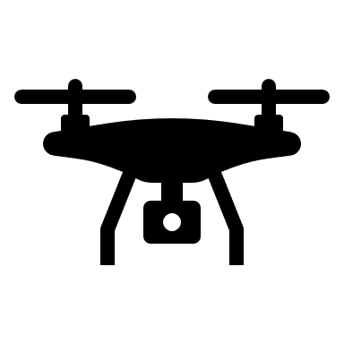







Definition of Teleoperation
Teleoperation is a term used for the remote operation of a robot/machine/system controlled by a human operator.
Human
Operator
Interface
Slave side: Physical or Virtual
Communication
Channel
Command
Signals
Sensor
Information
Master Control

Slide 3
Importance
Extraplanetary Exploration (Mars Rovers), Military Missions (reconnaissance, removing hazardous materials), Search and Rescue Operations (survivors of calamities)
Autonomous systems may face difficult problems in terms of tasks, terrains or situations that need teaming up with humans and that cannot be done alone.
Paramount to design a human-machine interface to maximize information while minimizing cognitive load.
Better situational awareness, greater immersion and reduced confusion.

Slide 4
Challenges
Teleoperation is facing increasingly complicated scenarios and refined tasks.
Latency which can cause degraded visual image/feedback or delayed control command [1].
Improper user-interface or feedback and thus limited information [2].
Motion sickness, Cognitive overload [3].

Slide 5
Literature Background
Auditory interface for teleoperation - Path following experimental results [4]
Cross-modal links among vision, audition, and touch in complex environments [5]
Auditory localization in teleoperator and virtual environment systems: ideas, issues, and problems [6]
The potentials for spatial audio to convey information in virtual environments [7]
EFFECTS OF INTERFACE TYPE ON NAVIGATION IN A VIRTUAL SPATIAL AUDITORY ENVIRONMENT Music and Audio [8]

Slide 6
Focus
Project is focused on auditory feedback couped with a visual display in VE for navigation.
Advantages over visual feedback:
Decreases visual workload.
Requires low-bandwidth communication links.
No significant information losses during congested network.
Require less computational power.

Slide 7



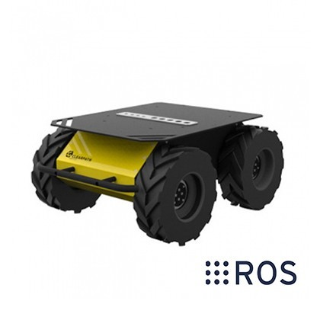
Main Tools
ROS Bridge
“Rosbridge provides a simple, socket-based programmatic access to robot interfaces and algorithms provided by ROS [9]”
Rendering and Interface side
Husky A200 UGV mobile base
Processing sensor information and ground truth environment

Slide 8
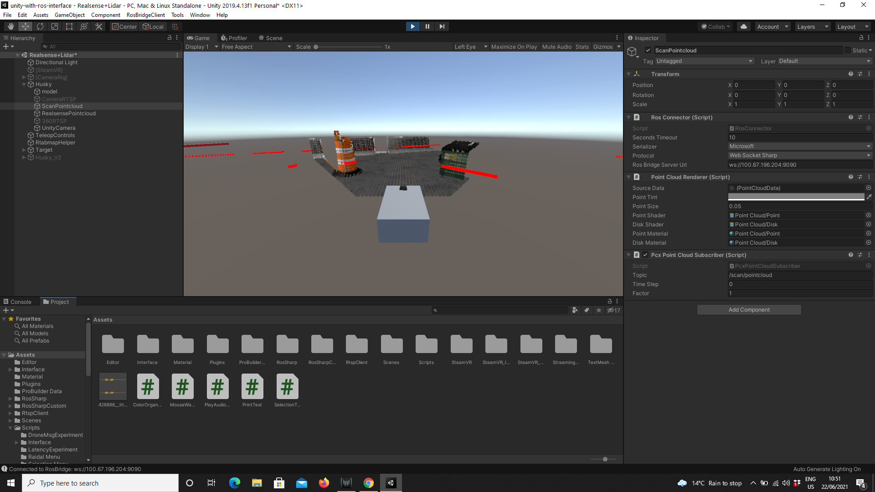
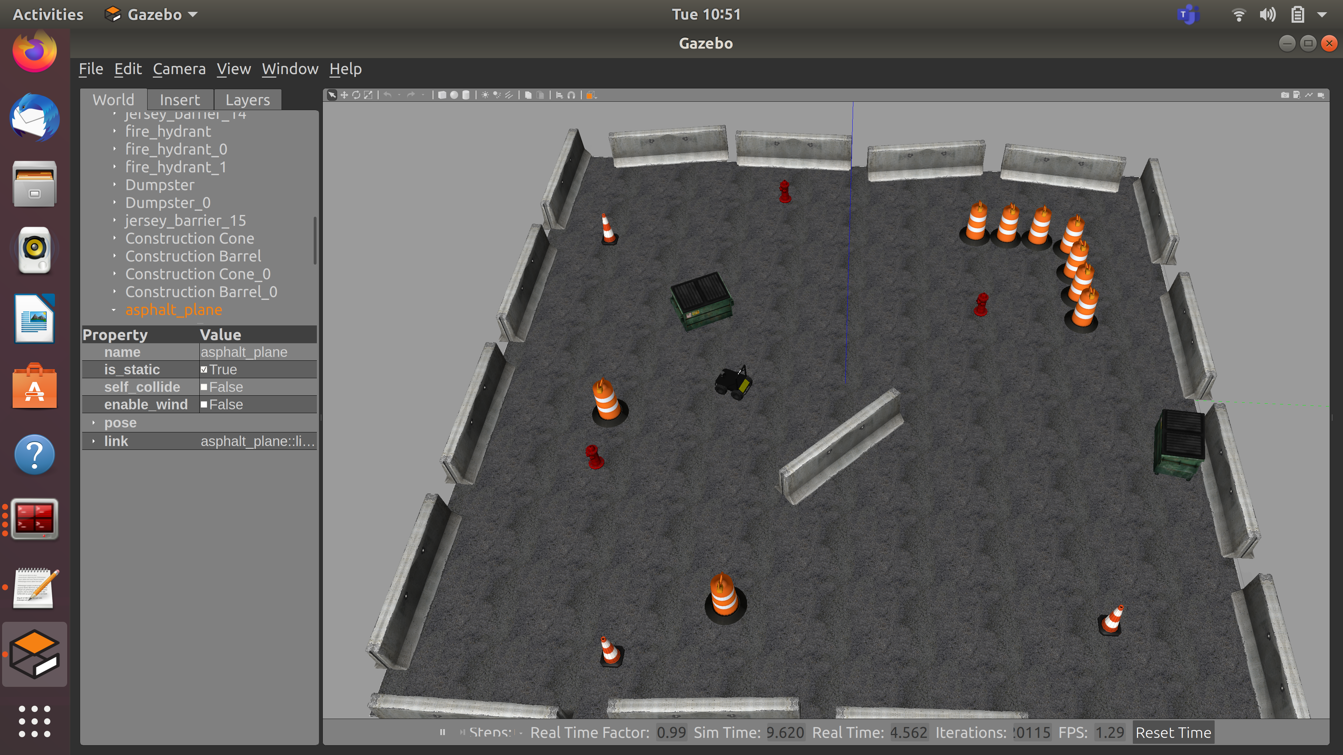
Experiment Setup
Unity: What the operators see on the screen
Gazebo: Ground truth of terrain

Slide 9
Preliminaries
Number of audio sources (2 or 4)
Position of the audio sources on the vehicle
Same or different clip(s)
Vary pitch only or volume only or both

Slide 10
Evaluation, Hypothesis and Expectations of Main Experiments
Scenarios:
Visual Only
Audio Only
Visual + Audio
Hypothesis - Is it worse to be blind or deaf? :
H1: Best performance for 3.
H2: Worst performance for 2.
Test interface based on user performance:
Navigate through different terrains
Avoid obstacles/Perform maneuvers
Time of completion
# of keystrokes
Add some effects:
Video degradation
Visual latency

Slide 11
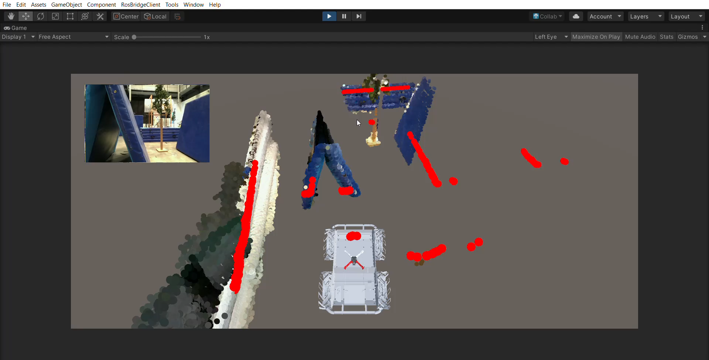
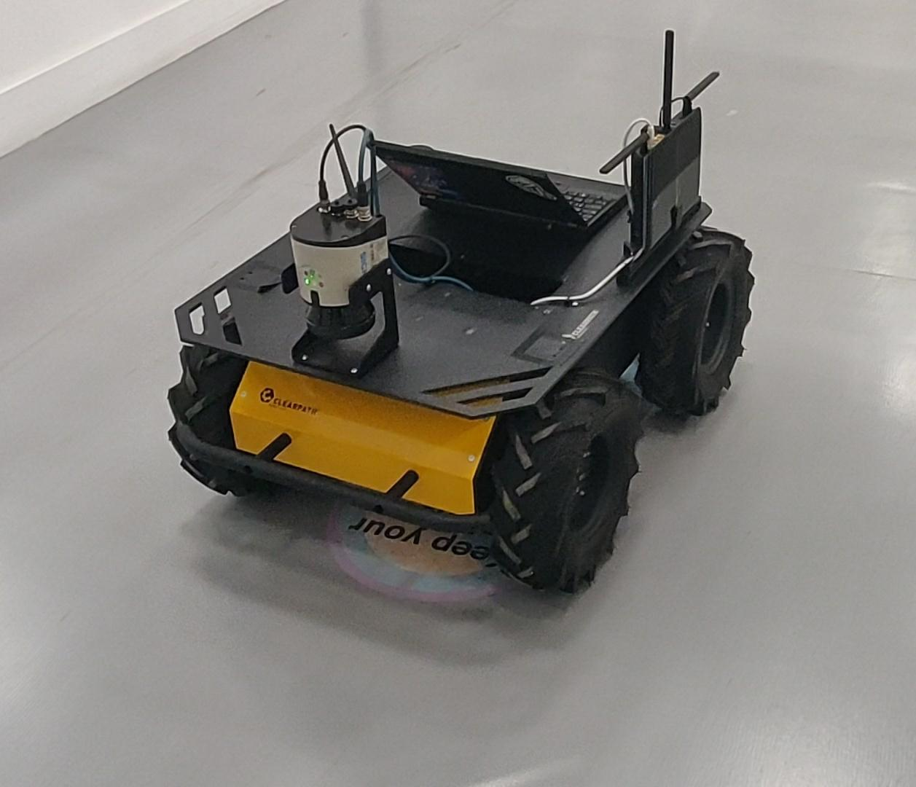
Bonus: Try on real Husky

Slide 13
References
https://www.frontiersin.org/articles/10.3389/frobt.2020.578805/full
Appl. Sci. 2020, 10, 6232; doi:10.3390/app10186232
https://ieeexplore.ieee.org/document/9026260
https://www.sciencedirect.com/science/article/pii/S1474667016422664
https://journals.sagepub.com/doi/10.1518/001872008X250566
https://ieeexplore.ieee.org/abstract/document/7006287
https://journals.sagepub.com/doi/10.1068/p200543
https://smartech.gatech.edu/handle/1853/49886
http://www.isrr-2011.org/ISRR-2011/Program_files/Papers/Jenkins-ISRR-2011.pdf

